Slide 1
COMMUNICATION
THAT WORKS
Using DISC to Strengthen Housing Authority Boards
Housing Authority Commissioners and Executive Leaders
01
Notes:
Welcome participants. Explain that communication directly affects decision quality, trust, and governance. Preview that DISC gives the board a shared language for adapting communication without asking everyone to become the same.

Slide 2
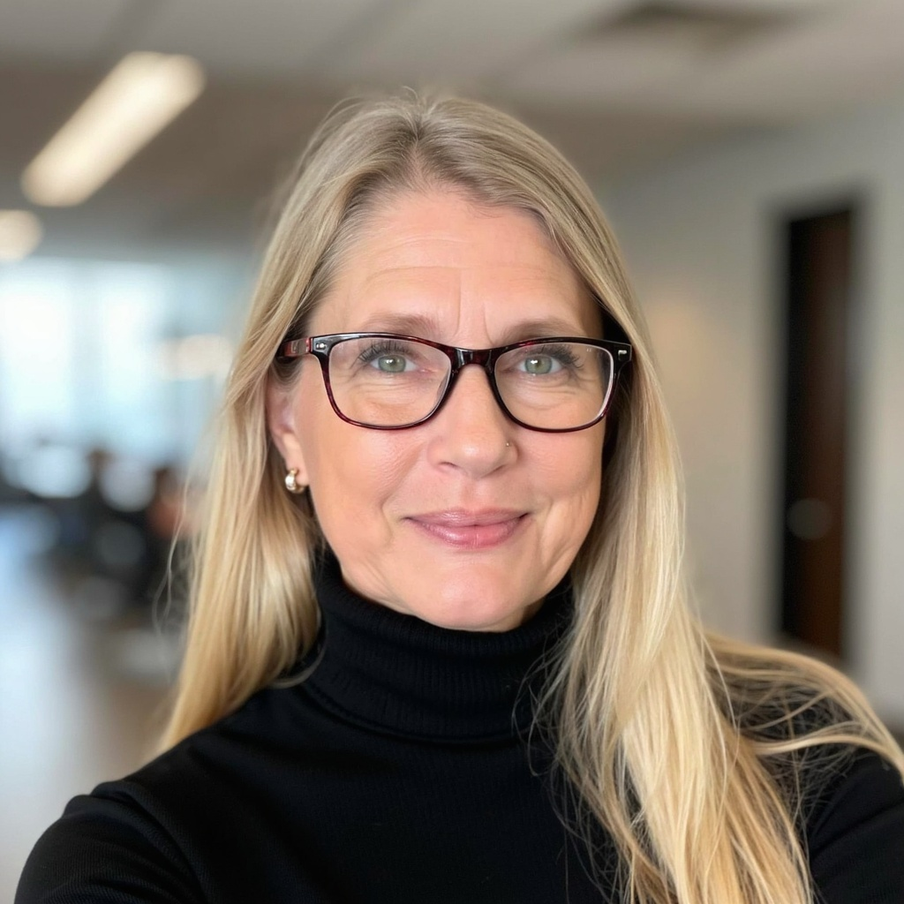
Sunny Shaw
Sunny Shaw & Associates
sunny@sunnyshaw.com
01
Notes:
Welcome participants. Explain that communication directly affects decision quality, trust, and governance. Preview that DISC gives the board a shared language for adapting communication without asking everyone to become the same.

Slide 3
Today’s outcomes
Recognize the four DISC communication styles
Adapt a message for different board members
Keep board and staff communication within governance roles
Handle disagreement without damaging trust
Choose one board communication practice to strengthen
02
Notes:
Review the outcomes quickly. Ask participants to listen for one idea they can apply at their next meeting.

Slide 4
What does strong board communication feel like?
Think of the best board you have served on or worked with.
What made its communication effective?
PAIR • SHARE • LISTEN FOR PATTERNS
04
Notes:
Invite participants to talk with a partner for two minutes. Then capture several answers. Listen for trust, respect, advance information, clear expectations, healthy disagreement, and no surprises.

Slide 5
Communication shapes governance outcomes
A small communication gap can become a governance problem
Communication
›
Trust
›
Decision quality
›
Governance effectiveness
When communication breaks down: misunderstanding, conflict, distrust, micromanagement
05
Notes:
Emphasize that effective communication is not merely about friendliness. Board communication affects the quality of public decisions and the clarity of accountability.

Slide 6
Board communication temperature check
Rate the board you know best
1
2
3
4
5
1 = a significant problem
5 = exceptionally strong
What would move your board up one point?
06
Notes:
Ask participants to rate silently. Invite two or three responses to the one-point improvement question. Reinforce that improvement can start with a small, observable behavior.

Slide 7
Seven communication traps
Most problems begin with ordinary habits
1
Information overload
5
Avoided conversations
2
Information gaps
6
Disagreement feels personal
3
Different preferences
7
Email and text tone
4
Individual direction to staff
07
Notes:
Ask which trap causes the most difficulty for boards participants have observed. Use their answers as the bridge to DISC: many conflicts begin with different natural communication preferences, not bad intent.

Slide 8
DISC gives boards a shared language
A behavioral framework for communication
D
I
DOMINANCE
INFLUENCE
Results and action
People and enthusiasm
S
C
STEADINESS
CONSCIENTIOUSNESS
Stability and support
Accuracy and evidence
DISC does not measure intelligence, competence, values, or worth.
08
Notes:
Explain that people often show a blend of styles and may adapt by situation. DISC should increase curiosity, not create labels or excuses.

Slide 9
D — Dominance / Demanding
Primary focus: results, action, challenge
D
“What’s the bottom line?”
BOARDROOM CONTRIBUTION
Drives decisions, challenges assumptions, addresses hard issues
WATCH FOR
Directness may sound impatient or aggressive
Lead with the result. Give options. State the decision needed.
ADAPT YOUR MESSAGE
09
Notes:
Introduce Dominance. Ask participants what this style contributes when the board is at its best. Then discuss how the same strength can become a communication challenge under pressure. Practical adaptation: Lead with the result. Give options. State the decision needed.

Slide 10
I — Influence
Primary focus: people, enthusiasm, interaction
I
“Let’s talk this through.”
BOARDROOM CONTRIBUTION
Builds relationships, creates energy, supports public engagement
Discussion may drift or details may get too little attention
WATCH FOR
Engage in dialogue. Connect the issue to people and impact.
ADAPT YOUR MESSAGE
10
Notes:
Introduce Influence. Ask participants what this style contributes when the board is at its best. Then discuss how the same strength can become a communication challenge under pressure. Practical adaptation: Engage in dialogue. Connect the issue to people and impact.

Slide 11
S — Steadiness
Primary focus: stability, cooperation, support
S
“How will this affect everyone?”
BOARDROOM CONTRIBUTION
Builds consensus, listens carefully, steadies the room
WATCH FOR
May avoid conflict or hold back disagreement
ADAPT YOUR MESSAGE
Give context and processing time. Explain how change will unfold.
11
Notes:
Introduce Steadiness. Ask participants what this style contributes when the board is at its best. Then discuss how the same strength can become a communication challenge under pressure. Practical adaptation: Give context and processing time. Explain how change will unfold.

Slide 12
C — Conscientiousness / Compliance
Primary focus: accuracy, quality, evidence
C
“What does the data show?”
BOARDROOM CONTRIBUTION
Finds risk, tests assumptions, protects compliance
WATCH FOR
May seek more information before deciding
ADAPT YOUR MESSAGE
Bring documentation, rationale, assumptions, and time for questions.
12
Notes:
Introduce Conscientiousness. Ask participants what this style contributes when the board is at its best. Then discuss how the same strength can become a communication challenge under pressure. Practical adaptation: Bring documentation, rationale, assumptions, and time for questions.

Slide 13
One issue, four useful lenses
A strong board benefits from all four perspectives
D
Opportunity, risk, recommendation, timing
I
Community support, relationships, public message
S
Resident impact, staff capacity, implementation
C
Financial model, assumptions, compliance, risk
13
Notes:
Reinforce that no single lens is complete. The goal is to benefit from each perspective while maintaining meeting discipline and a shared decision process.

Slide 14
Boardroom scenario: 75 new affordable homes
The Executive Director asks for authority to begin due diligence
A property acquisition could add 75 affordable housing units. The board must decide whether staff should move forward with due diligence.
What would each DISC style want to know before voting?
14
Notes:
Place participants in groups. Assign each group one DISC style or ask every group to consider all four. Allow four minutes, then debrief. Listen for questions that reflect opportunity, people, implementation, and evidence.

Slide 15
Four commissioners respond
Different questions can improve the same decision
D
I
DOMINANCE
INFLUENCE
Results and action
People and enthusiasm
S
C
STEADINESS
CONSCIENTIOUSNESS
Stability and support
Accuracy and evidence
15
Notes:
Debrief the property scenario. D asks about opportunity, risk, recommendation, and timing. I asks about support and public communication. S asks about residents, staff, capacity, and consultation. C asks about the financial model, assumptions, due diligence, and regulations.

Slide 16
Use DISC for adaptation, not labeling
Curiosity keeps the framework useful
Helpful
Harmful
What information would help?
That is just how Ds are
How can I make this clearer?
Cs always slow us down
What strength is showing up?
She cannot change her style
A style explains a preference. It does not excuse disrespect or poor governance.
16
Notes:
DISC can become counterproductive when people use it to stereotype or excuse behavior. Encourage participants to discuss observable communication needs rather than assigning identities to others.

Slide 17
The same recommendation, delivered four ways
The facts remain consistent. The emphasis changes.
D
Recommendation, cost, risk, decision tonight
I
Resident impact and community partnerships
S
Implementation plan and support through change
C
Projections, assumptions, requirements, documents
17
Notes:
Demonstrate how an Executive Director can prepare one sound recommendation and make it accessible to multiple communication preferences. The underlying facts and recommendation do not change.

Slide 18
Clear communication follows clear authority
The board governs collectively through the Executive Director
BOARD
›
EXECUTIVE DIRECTOR
›
STAFF
Individual commissioners ask for information through agreed channels. They do not direct staff.
18
Notes:
Explain the governance communication lane: Board to Executive Director to staff. Clarify local policies may permit routine staff contact, but individual commissioners should not give direction or create competing priorities.

Slide 19
The Board Chair and Executive Director set the tone
Regular communication prevents surprises
Clarify the meeting purpose
Agree on decisions needed
Surface sensitive issues early
Confirm who communicates next steps
Consistency builds confidence across every DISC style.
20
Notes:
Discuss a regular Chair and Executive Director check-in before each meeting. This partnership does not replace communication with the full board. It helps prepare a clear agenda, identify decisions, and avoid surprises.

Slide 20
Conflict scenario: questions become personal
A repeated pattern changes the whole room
One commissioner repeatedly questions operational decisions. The Executive Director becomes defensive. Other commissioners stop participating.
What should the Chair do?
What is the communication problem?
What should the Executive Director do?
What should the board do together?
21
Notes:
Give groups five minutes. Ask them to separate the substantive governance question from the communication pattern. Debrief the roles of the Chair, Executive Director, and collective board.

Slide 21
Language can lower the temperature
Challenge the issue without attacking the person
Instead of
Try
You clearly didn’t think this through.
›
Help me understand the factors behind this recommendation.
This makes absolutely no sense.
›
I’m not comfortable yet. Could we review the assumptions?
22
Notes:
Ask volunteers to read each pair aloud. Discuss how the revised language protects candor while opening space for explanation.

Slide 22
A four-step difficult conversation
Structure keeps the discussion on the issue
1
2
3
4
DESCRIBE
CLARIFY
DISCUSS
DECIDE
What happened?
What do we need to understand?
What perspectives need to be heard?
What happens next?
Slow the conversation down before deciding who is right.
23
Notes:
Walk through the model. Describe observable facts without motives. Clarify missing information. Discuss relevant perspectives. Decide the action, owner, and follow-up.

Slide 23
Pressure can amplify each style
Self-awareness creates a pause before reaction
D
Pushes harder or interrupts
Pause • Notice • Adapt
I
Talks more or loses focus
Pause • Notice • Adapt
S
Withdraws or agrees too quickly
Pause • Notice • Adapt
C
Adds analysis or delays commitment
Pause • Notice • Adapt
24
Notes:
Invite private reflection: What happens to your communication under pressure? Emphasize that a stress response may look different for each person and that participants should focus on their own observable behavior.

Slide 24
Communication agreements make expectations visible
Boards can adopt a short set of meeting norms
Disagree with ideas without attacking people
Ask questions before making assumptions
Listen to understand the concern
Share important information with all commissioners
Keep direction to staff within the governance structure
Address difficult issues before they grow
Respect the board’s final decision
25
Notes:
Ask participants to select the agreement that would make the biggest difference on their board. Encourage boards to adopt a manageable set and revisit them during orientation and retreats.

Slide 25
A communication-ready board meeting
Good habits begin before the gavel
BEFORE
DURING
AFTER
Clear purpose
Decision identified
Packet sent on time
Questions routed early
Decision communicated
Assignments confirmed
Minutes reflect action
Follow-up stays in lane
Chair protects the process
Questions stay respectful
Different lenses surface
Next steps are explicit
26
Notes:
Use this checklist to connect DISC with meeting systems. Clear preparation helps every style. It reduces last-minute pressure for D, gives I a defined space for discussion, supports S through change, and gives C evidence to review.

Slide 26
My next-meeting commitment
One observable change is enough to start
My natural communication tendency is…
Under pressure, I tend to…
A style I need to communicate with more effectively is…
At my next board meeting, I will…
27
Notes:
Give participants two quiet minutes to write. Invite them to make the final commitment specific and observable. Examples include leading with the recommendation, asking one clarifying question, pausing before responding, or requesting data before the meeting.

Slide 27
The 30-day board challenge
Turn one workshop insight into a shared practice
WEEK 1
WEEK 2
WEEK 3
WEEK 4
Select one communication agreement
Use it during a board mtng
Ask what improved and what did not
Keep, revise, or replace the practice
Small agreements become culture when boards use them consistently.
28
Notes:
Offer this as a practical follow-through activity. The board should choose only one agreement so it can notice whether behavior changes.

Slide 28
Different styles.
Shared responsibility.
D
I
RESULTS
PEOPLE
Strong boards communicate differently and still govern effectively together.
S
C
SUPPORT
DATA
What will you change at your next meeting?
29
Notes:
Close by reinforcing that the goal is not identical communication. The goal is shared expectations, clear governance boundaries, respectful disagreement, sound information, and an ability to adapt. Thank participants and invite final questions.

Slide 29
D
I
Questions?
RESULTS
PEOPLE
S
C
SUPPORT
DATA
Thank you!
29
Notes:
Close by reinforcing that the goal is not identical communication. The goal is shared expectations, clear governance boundaries, respectful disagreement, sound information, and an ability to adapt. Thank participants and invite final questions.

